Slide 1

OSU HEALTH CENTRE
Anushka Aravelli

Slide 2
Introduction of OSU Health Centre application
Comprehensive Medical Services:
Health checkups tailored to OSU students
Appointment booking
Doctor consultations
Access to lab tests, reports, and prescriptions
Efficient Record Management:
Vaccination records management
Appointment reminders via email

Slide 3
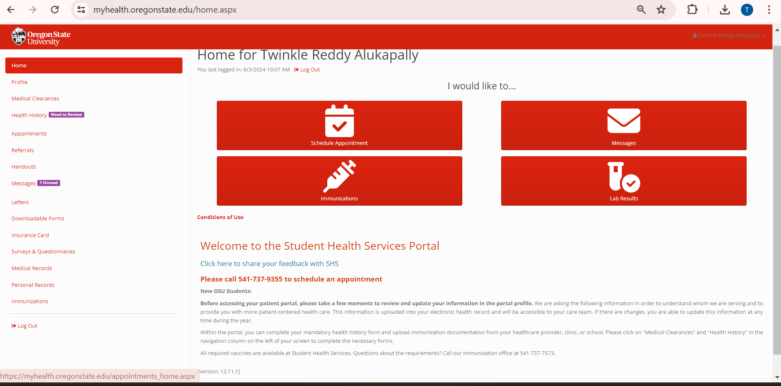
Issues Identified and Fixes Implemented
Bug ID 1: Addition of calling feature and information about calling hours
Issue: On our homepage, the provided contact number lacks visibility and does not offer information on operating hours, leading to user inconvenience.

Slide 4
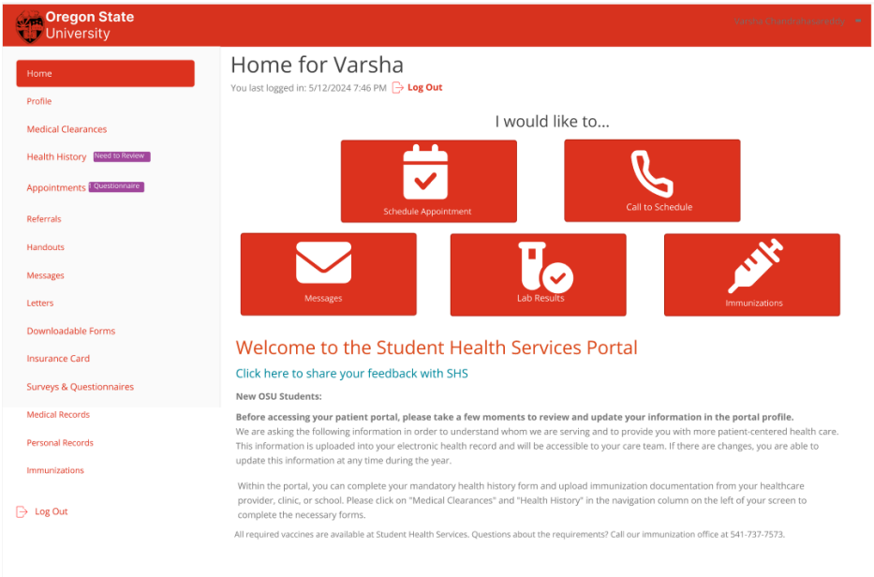
Fix: Introducing a prominent call icon on the existing homepage. Upon clicking, it seamlessly redirects users to detailed contact information and operating hours, ensuring a user-friendly interface.

Slide 5
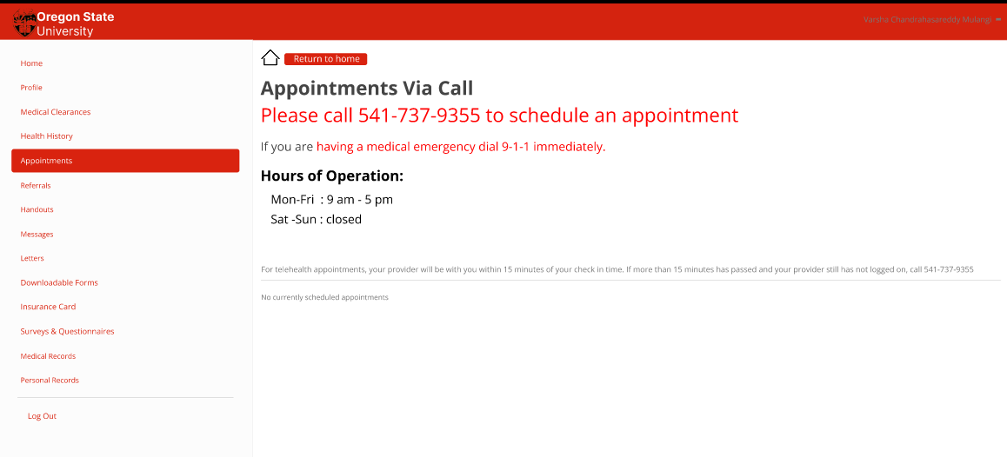

Slide 6
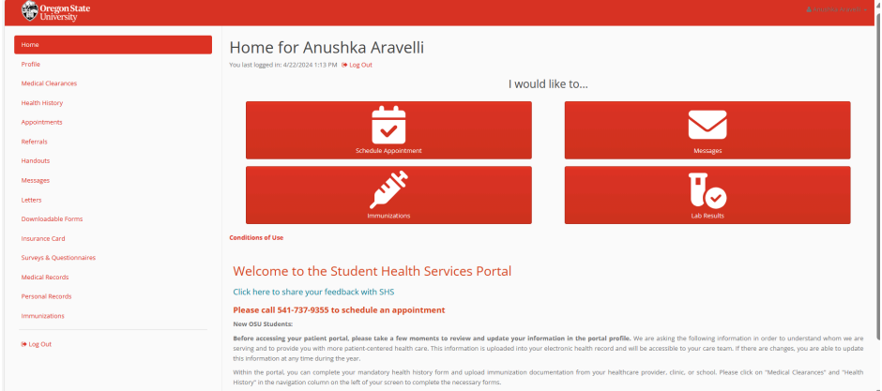
Bug ID 2: Rearrangement of conditions of use Issue: Users are not aware of terms and conditions and billing practices due to inadequate presentation on the main page, leading to a lack of important information awareness.

Slide 7
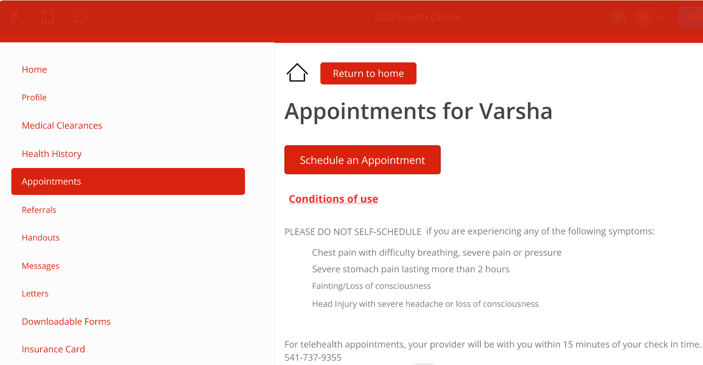
Fix: I've relocated the conditions of use to a dedicated online page accessible during scheduled appointments. Featuring prominent text and enhanced visibility, users can now easily explore and understand essential information.

Slide 8
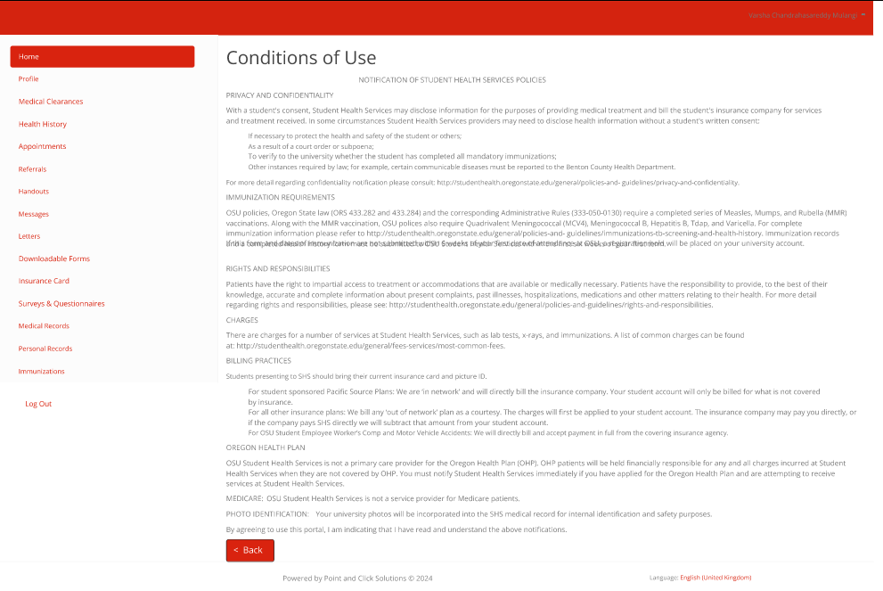
When the user clicks on "Conditions of Use," the "Billing Practices" page opens.

Slide 9
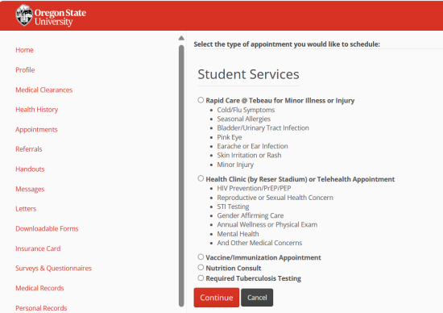
.
Bug ID3: Information i button
​ Issue: Technical terms in student services are challenging to understand for users.

Slide 10
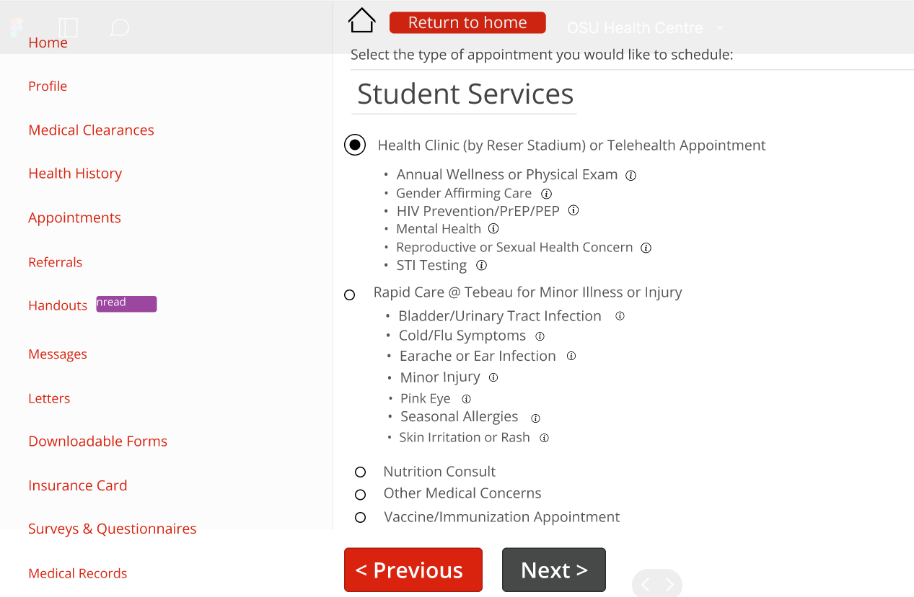
Fix: Introducing information pages for quick access to explanations of technical terms, ensuring clarity and ease of understanding.

Slide 11
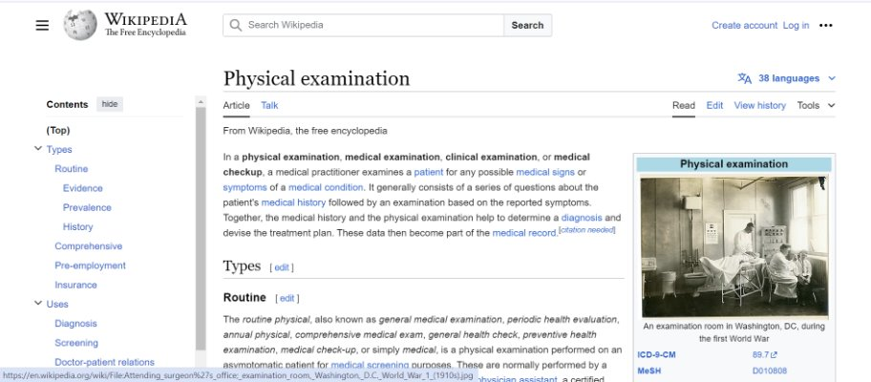
Clicking the "I" button leads to a Wikipedia page about the relevant disease.

Slide 12
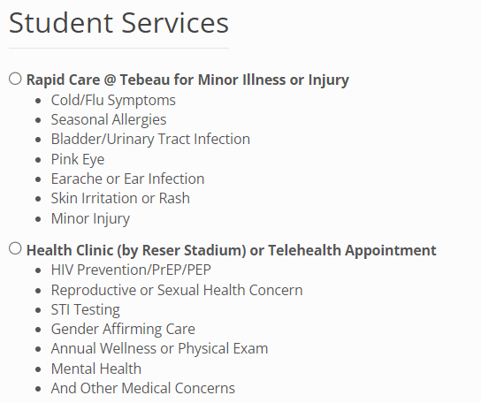
Bug ID 4: Alphabetical order
Issue : The web-based application currently displays a list of concerns that are not sorted in alphabetical order. This can cause difficulty for users trying to locate specific concerns quickly.

Slide 13
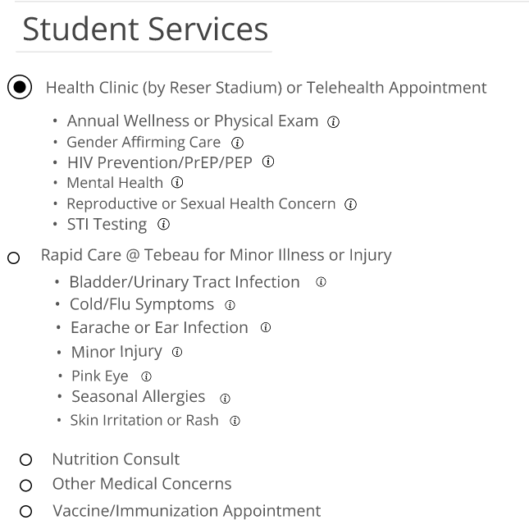
Fix: Implemented the alphabetical sorting mechanism for the list of concerns to enhance user experience and improve accessibility.

Slide 14
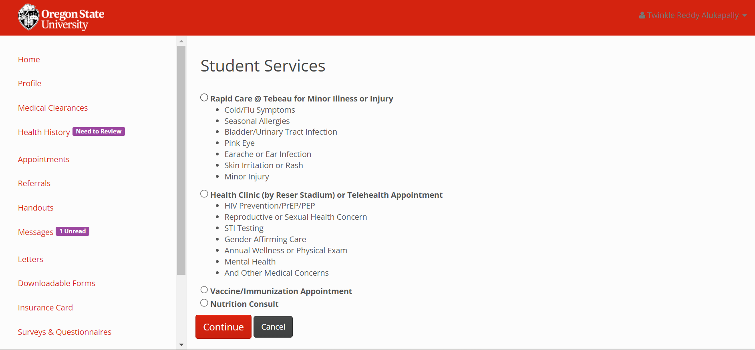
Bug ID 5: Return to home button
​
​ Issue: Users lack the option to return to the home screen from any page.

Slide 15
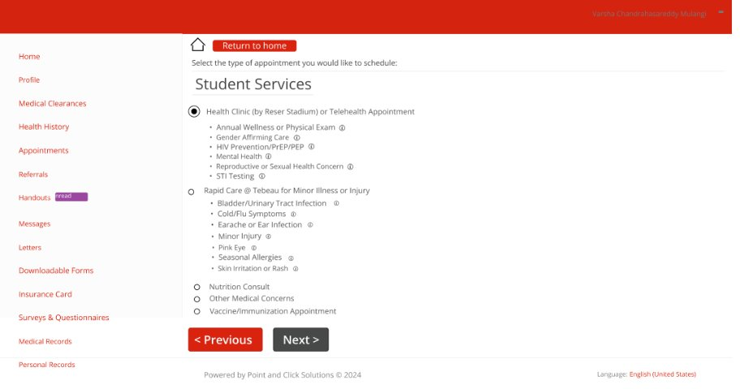
Fix: Introducing a home button for seamless navigation, allowing users to easily return to the home page from any screen without hassle.

Slide 16
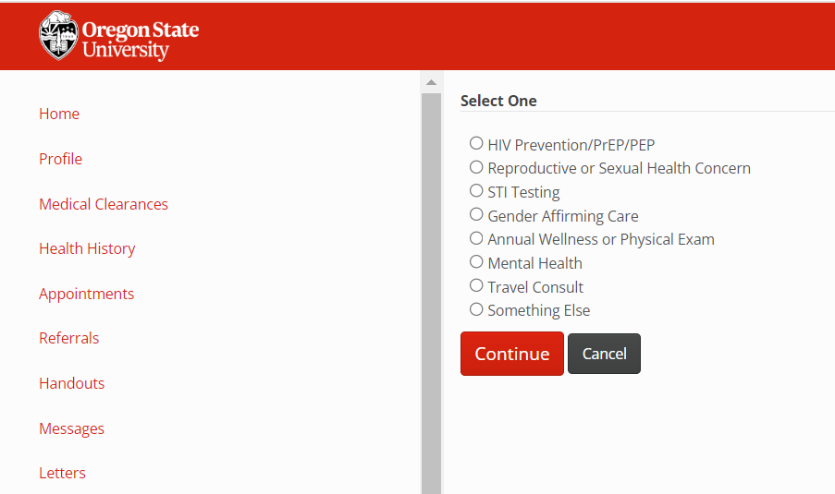
Bug ID 6 & 7: Previous button and Next button
Issue: Users lack a convenient way to navigate back to the previous screen from the current one and has the option continue to proceed.

Slide 17
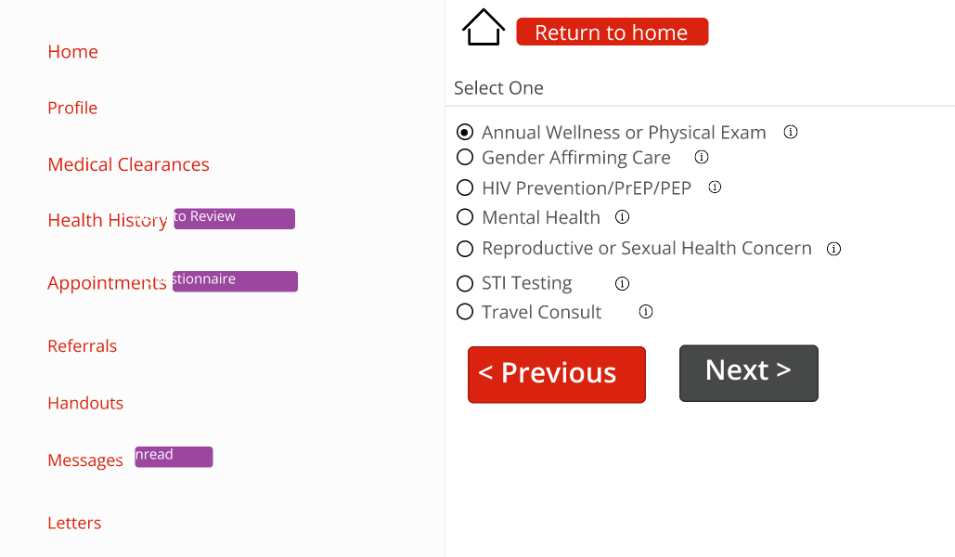
Fix: I've enhanced the navigation experience by adding a "Previous" button for backtracking and replacing the "Continue" button with a more intuitive "Next" button for seamless forward movement.

Slide 18
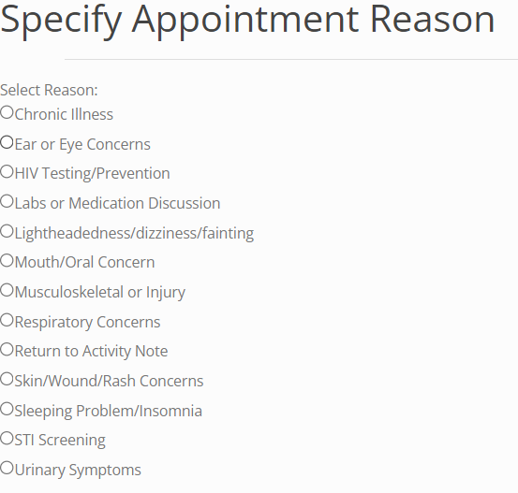
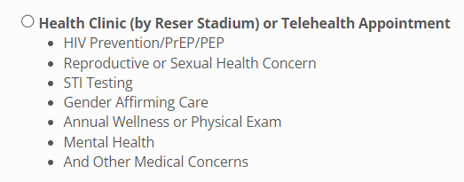
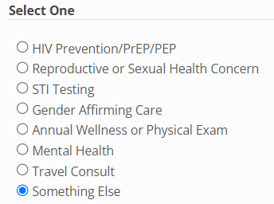
Bug ID 8. Rearrangement of other medical concerns
Issue : Medical concerns that do not fall under the main categories are scattered and confusingly placed within the services section. This disorganization can lead to difficulty for users in finding specific medical concerns and requires navigating through multiple screens.

Slide 19
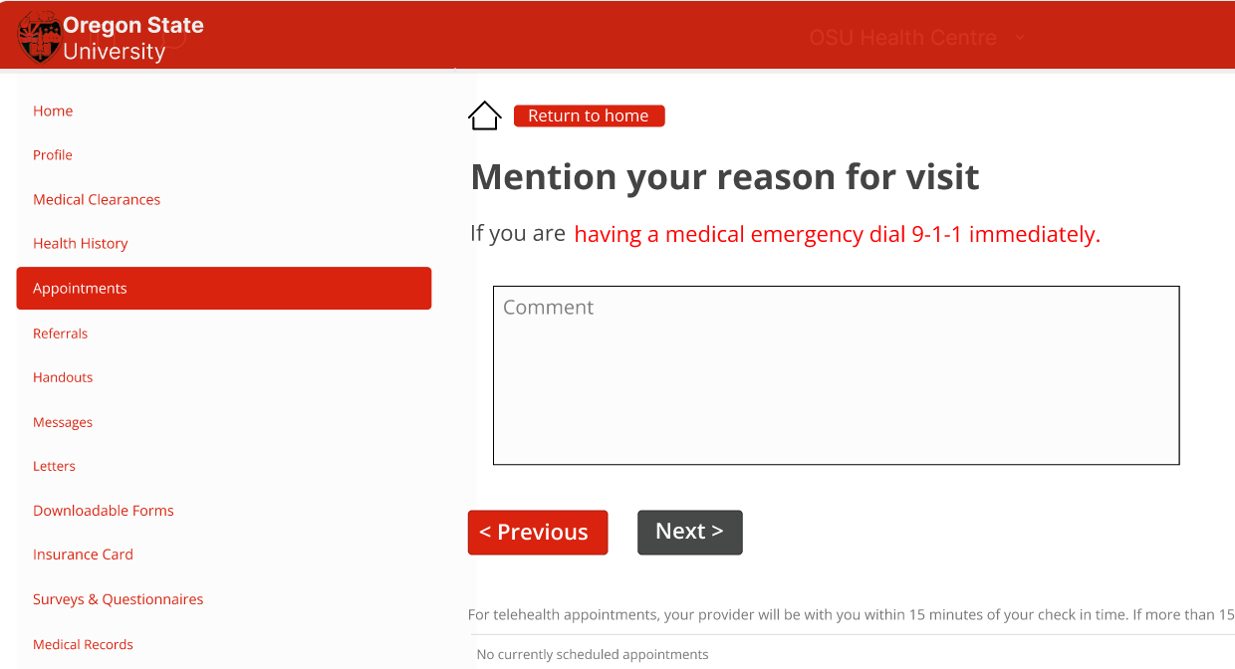
Fix: We've segregated these miscellaneous medical concerns into a separate section labelled "Other Medical Concerns." This ensures clarity for users who may not find the specific service they're looking for, by typing their concern in the comment box section.

Slide 20
Figma prototype:
https://www.figma.com/proto/lBMvi1bJ27kki1SQsJIZVf/OSU-Health-Centre?node-id=22-263&t=dFKhr6MmEaQvBrG2-1&scaling=min-zoom&page-id=0%3A1&starting-point-node-id=39%3A95

Slide 21
THANK YOU

